Slide 1
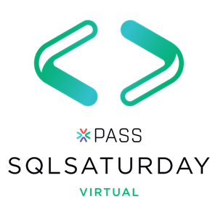





#1000 Oregon

Slide 2

Rob Sewell
Bearded Consultant
Automator
Trainer
Dual MVP
Consultant Sewells Consulting Ltd
dbatoolsMoL dbachecks
ADSNotebooks PowerShell Community
Data Community
beard.media\book
@sqldbawithbeard
blog.robsewell.com

Slide 3

I Ain’t No Data Scientist
Why Do I Need Jupyter Notebooks?
Notes:
OBS:SpeakerBottomLeftSquare

Slide 4
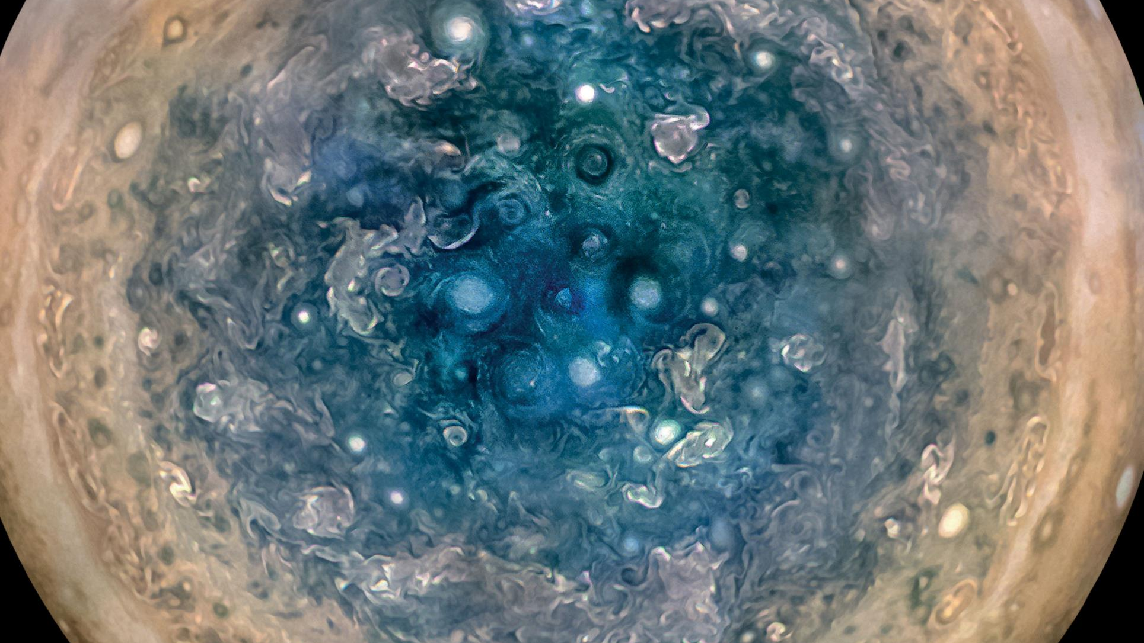

Slide 5
First, the names comes from the planet Jupiter. We wanted to pick a name that evoked the traditions and ideas of science.
Jupyter
Notes:
OBS:SpeakerTopRight

Slide 6
Jupyter
First, the names comes from the planet Jupiter. We wanted to pick a name that evoked the traditions and ideas of science.
Second, the core programming languages supported by Jupyter are Julia, Python and R. While the name Jupyter is not a direct acronym for these languages, it nods its head in those directions. In particular, the "y" in the middle of Jupyter was chosen to honor our Python heritage. See the logos of these languages in the languages folder of this repo.
https://github.com/jupyter/design/wiki/Jupyter-Logo
Notes:
OBS:SpeakerTopRight

Slide 7
Jupyter
Second, the core programming languages
supported by Jupyter are
Julia, Python and R.
While the name Jupyter is not a direct acronym for these languages, it nods its head in those directions.
In particular, the "y" in the middle of Jupyter was chosen to honor our Python heritage.
Third, Galileo was the first person to discover the moons of Jupiter. His publication on the moons of Jupiter is an early example of research that includes the underlying data in the publication. This is one of the core ideas and requirements for scientific reproducibility. Reproducibility is one of the main focuses of our project.
https://github.com/jupyter/design/wiki/Jupyter-Logo
Notes:
OBS:SpeakerTopRight

Slide 8
Jupyter
Third, Galileo was the first person to discover the moons of Jupiter. His publication on the moons of Jupiter is an early example of research that includes the underlying data in the publication.
This is one of the core ideas and requirements for scientific reproducibility. Reproducibility is one of the main focuses of our project.
https://github.com/jupyter/design/wiki/Jupyter-Logo
Notes:
OBS:SpeakerTopRight

Slide 9
So – What IS a Jupyter Notebook?
Originally for Data Scientists
Notes:
OBS:SpeakerTinySquare

Slide 10
First – Lets go back in time

Slide 11
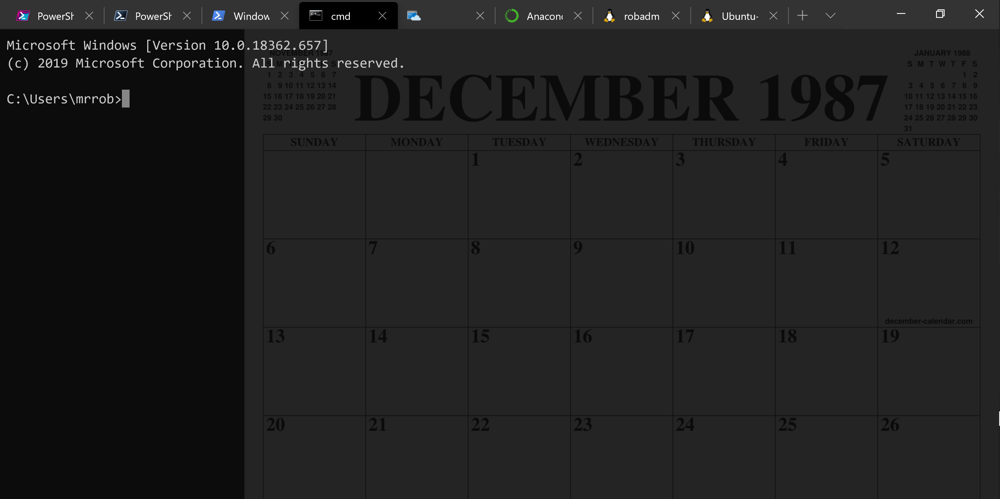
A Decade and a Half

Slide 12
Uh, Houston, we've had a problem
https://en.wikipedia.org/wiki/Houston,_we_have_a_problem

Slide 13

Running Queries
@SQLDBAWithBeard blog.robsewell.com Rob Sewell beard.media/book

Slide 14
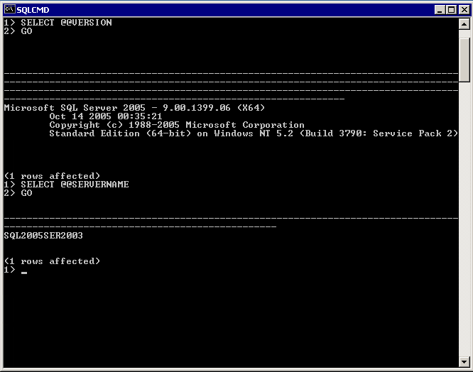
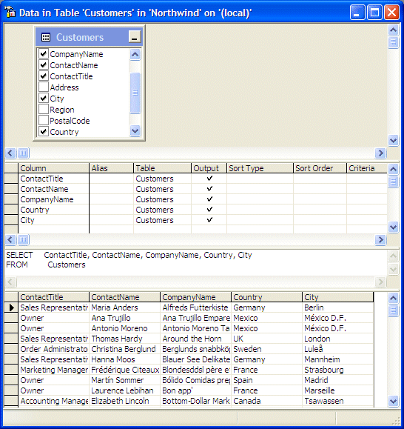
@SQLDBAWithBeard blog.robsewell.com Rob Sewell beard.media/book

Slide 15
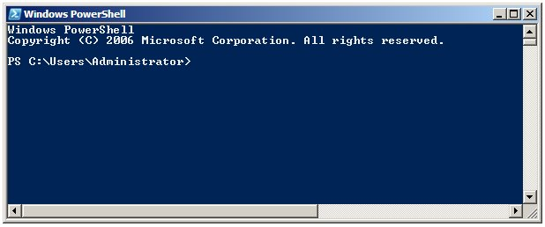
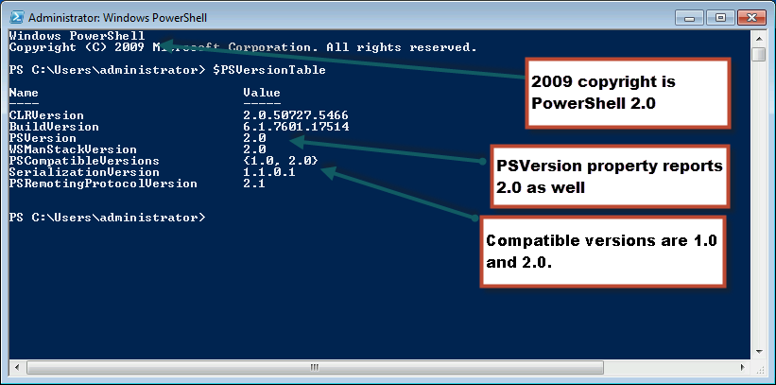
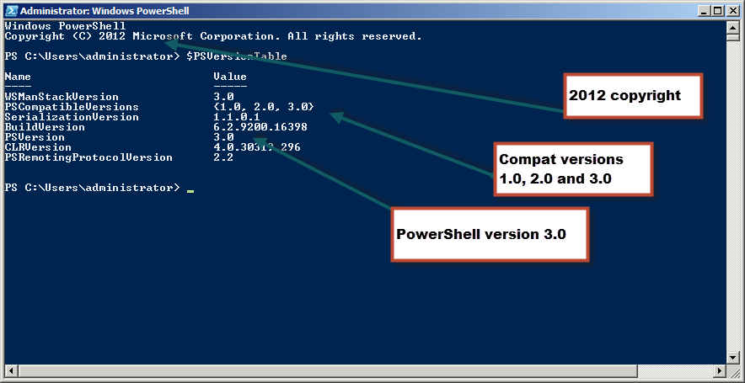
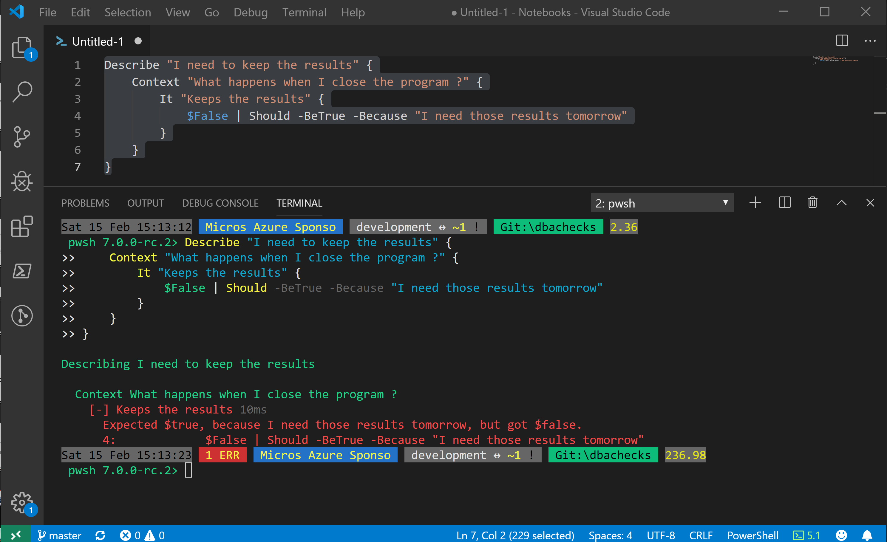
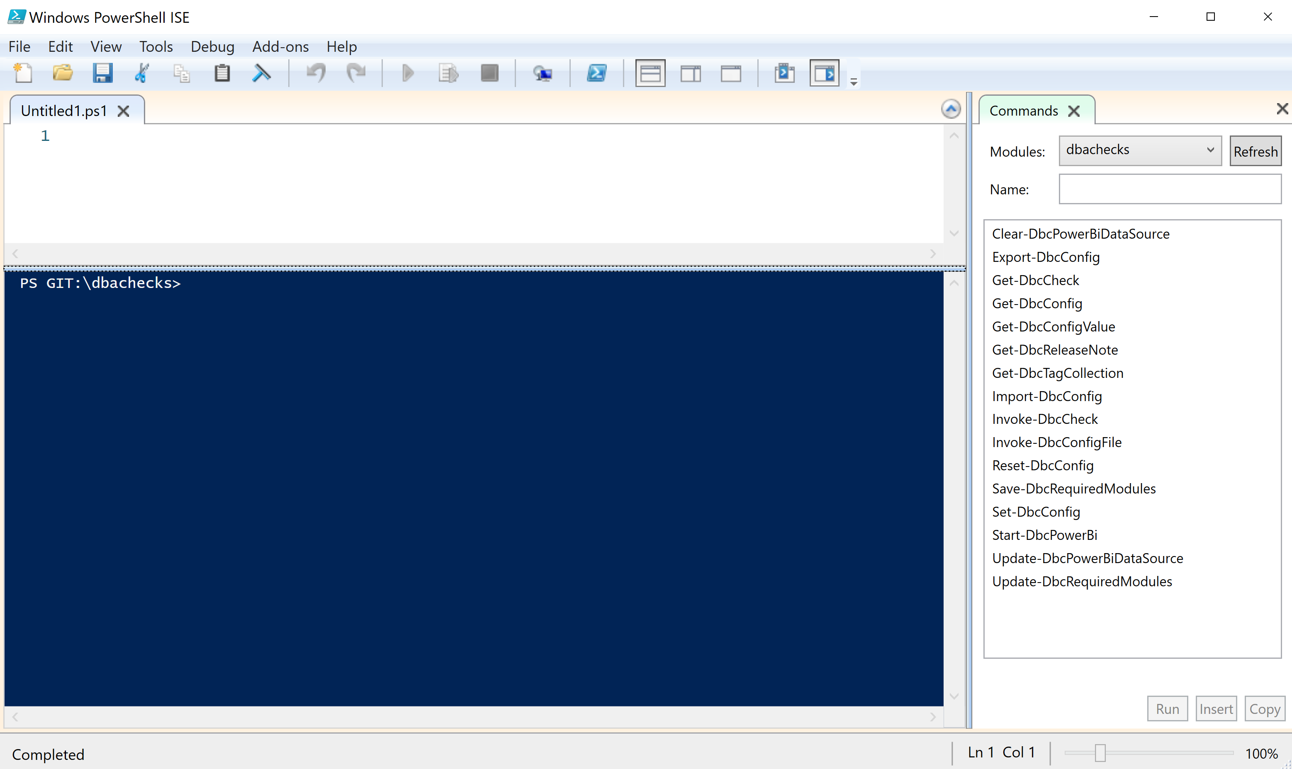
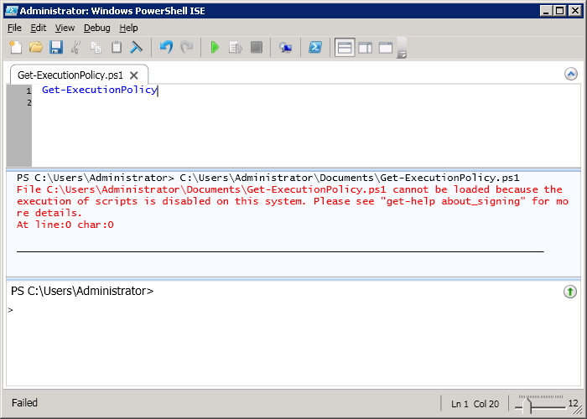
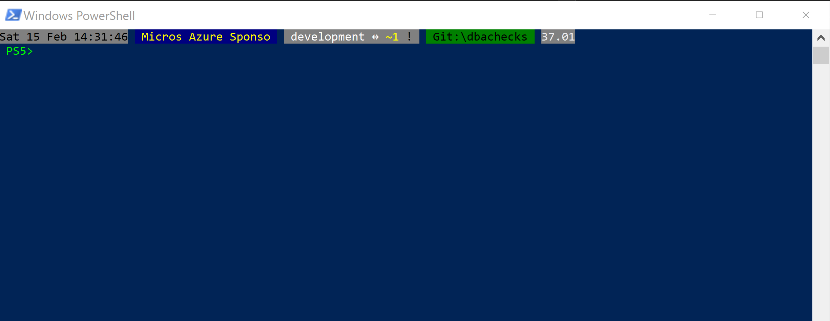
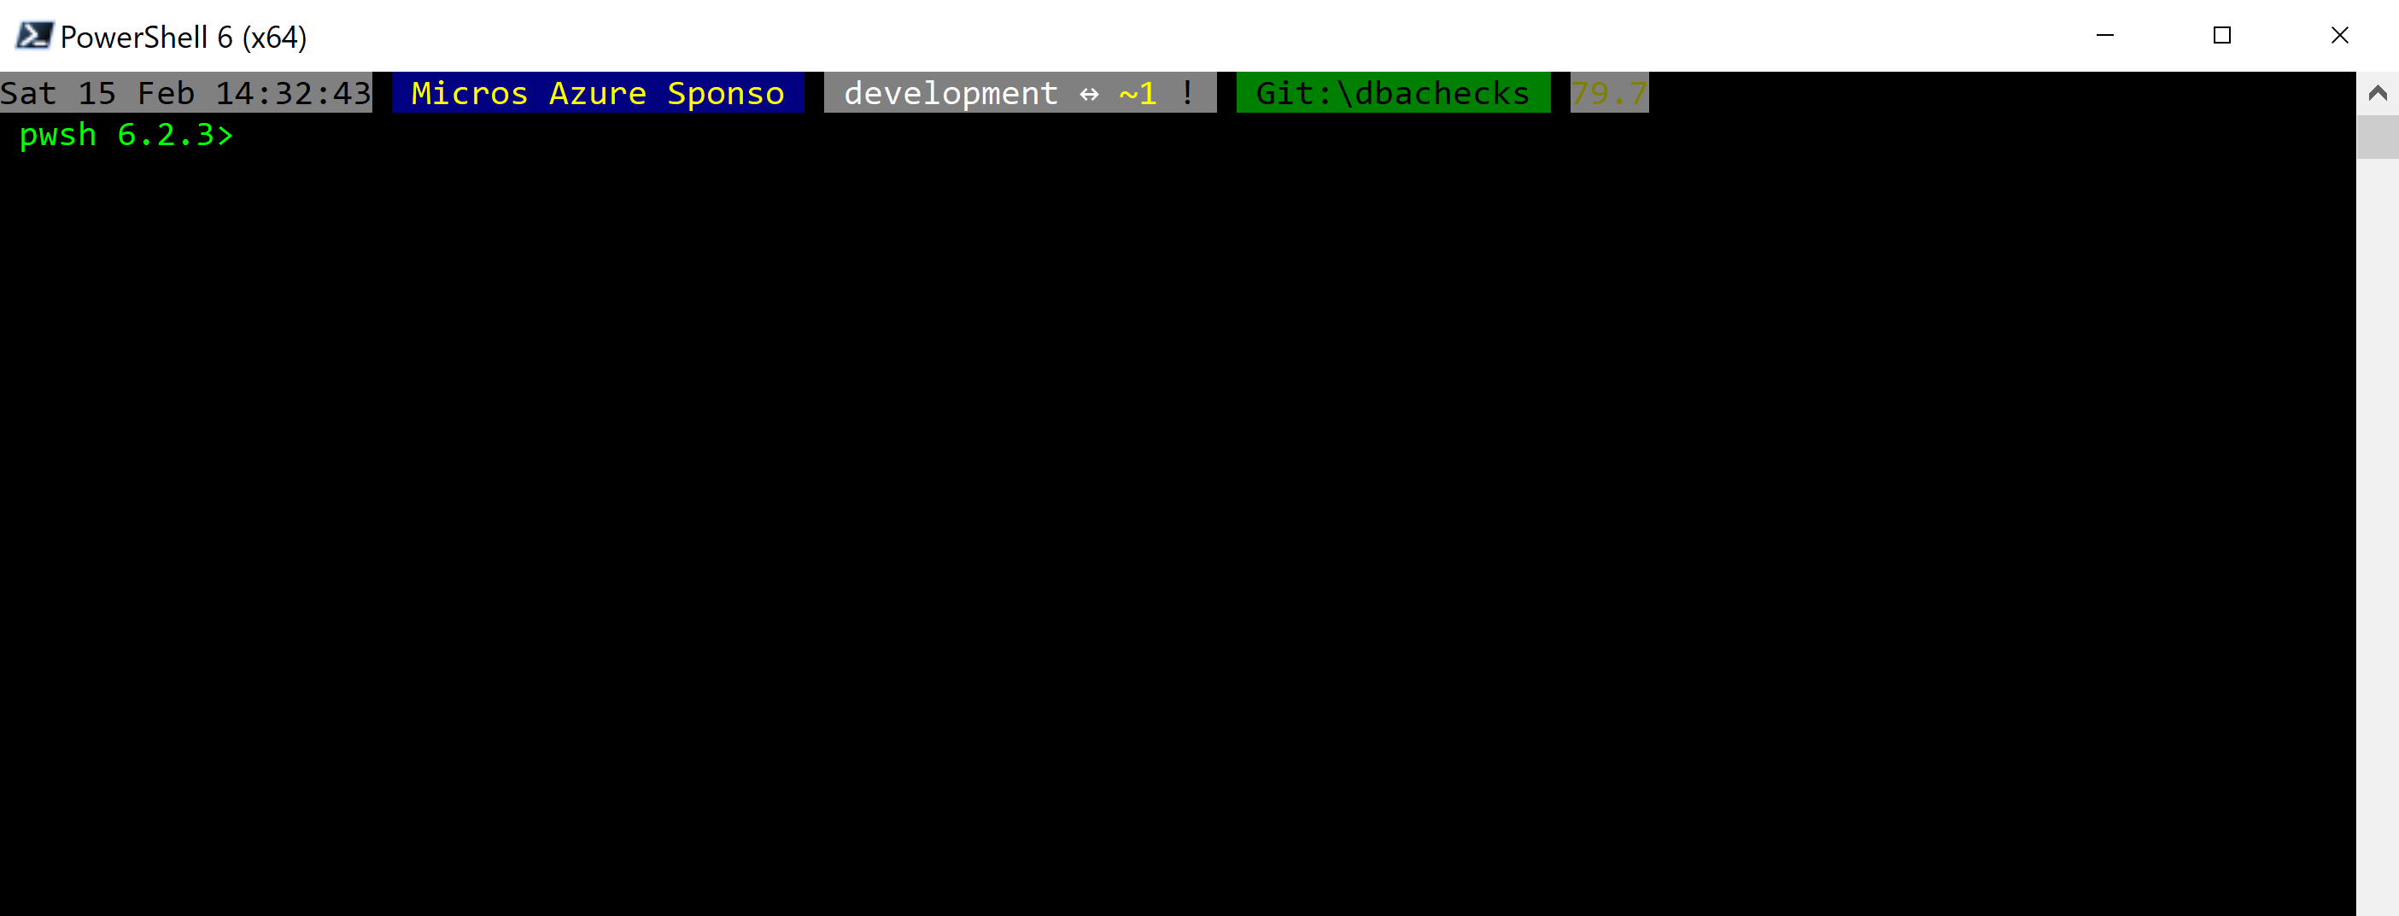
Without some effort………..
Notes:
OBS:SpeakerCentreBottom

Slide 16
Without some effort………..
Notes:
OBS:SpeakerCentreBottom

Slide 17
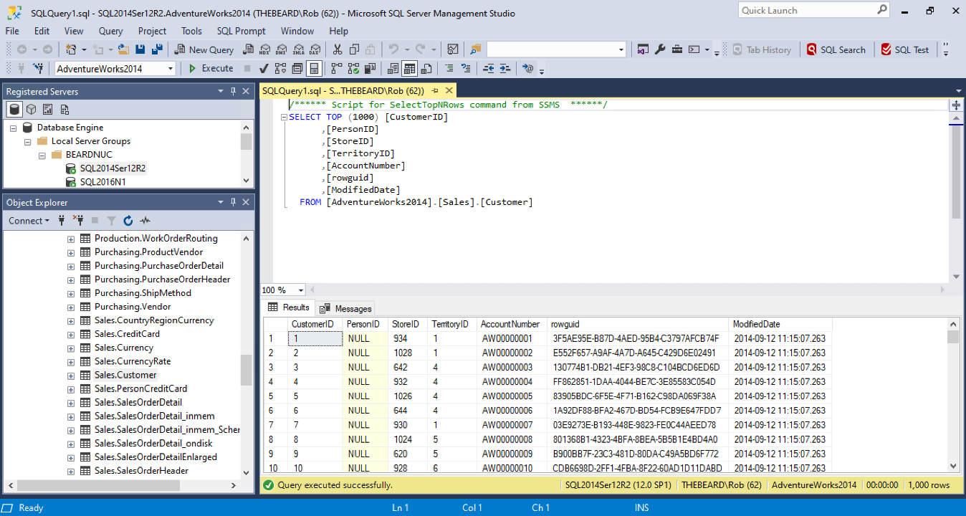

Slide 18
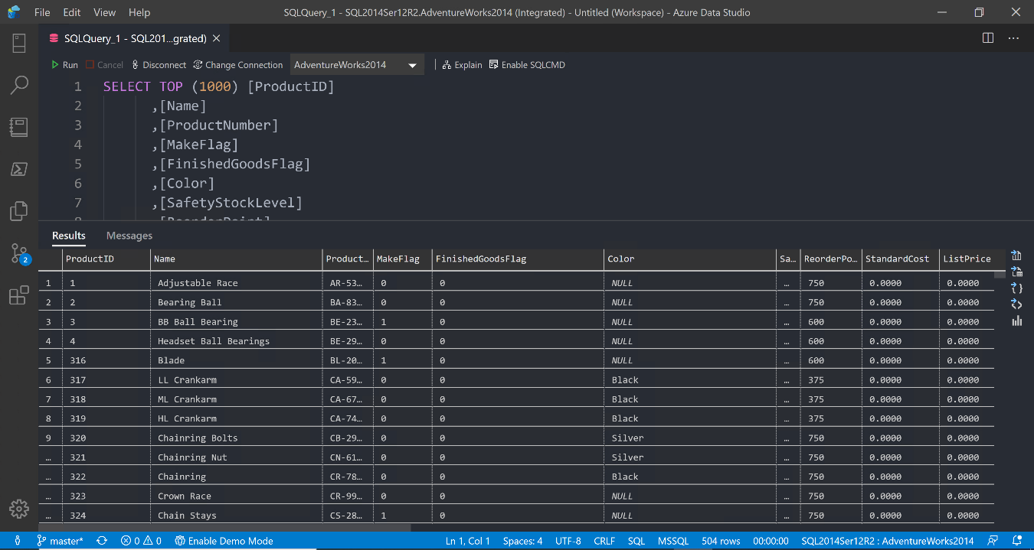

Slide 24
ALL
GONE

Slide 25
What is a Jupyter Notebook?
Document that can contain text, code, images and query results
Notes:
OBS:SpeakerCentreBottom

Slide 26
Database performance woes?
Ask for help!
Your local Microsoft Partners and consultants are here to help
Marquam’s SQL Server Assessment provides tuning, optimization, migration, and cloud readiness guidance
Contact: info@marquam.com

Slide 27
What is a Jupyter Notebook?
Document that can contain text, code, images and query results
Notes:
OBS:SpeakerCentreBottom

Slide 28
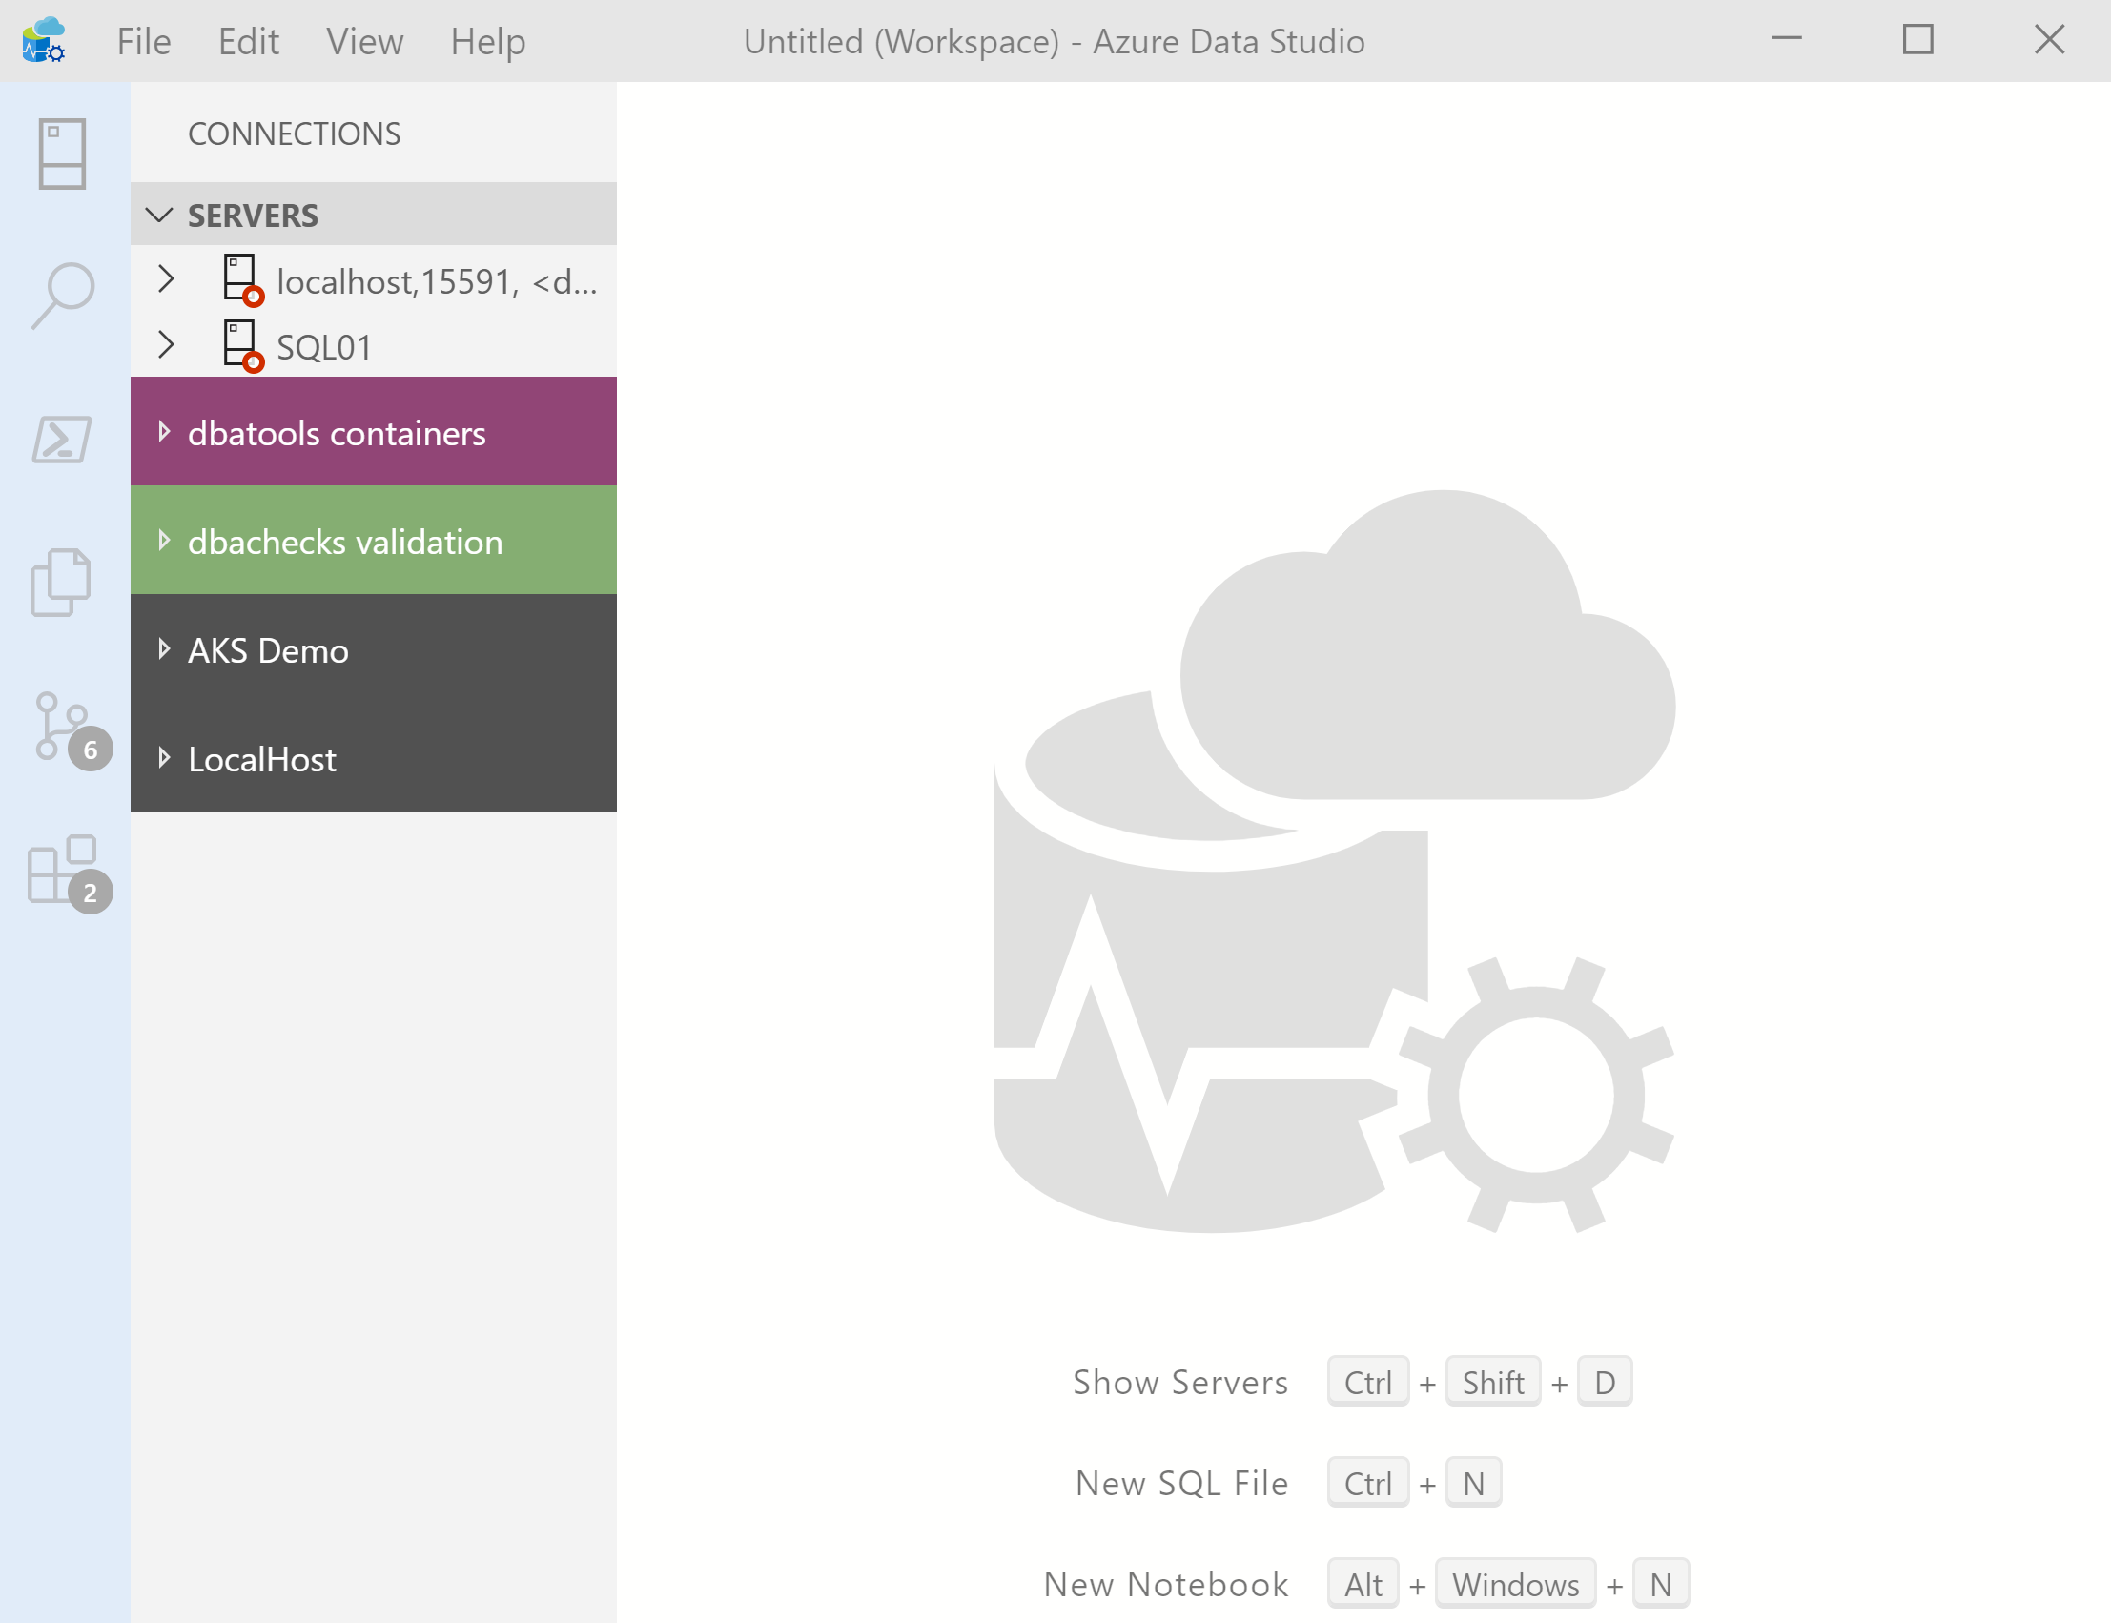
What’s Azure Data Studio ?
Cross Platform desktop environment for Data Professionals
Notes:
OBS:SpeakerCentreSquare

Slide 29
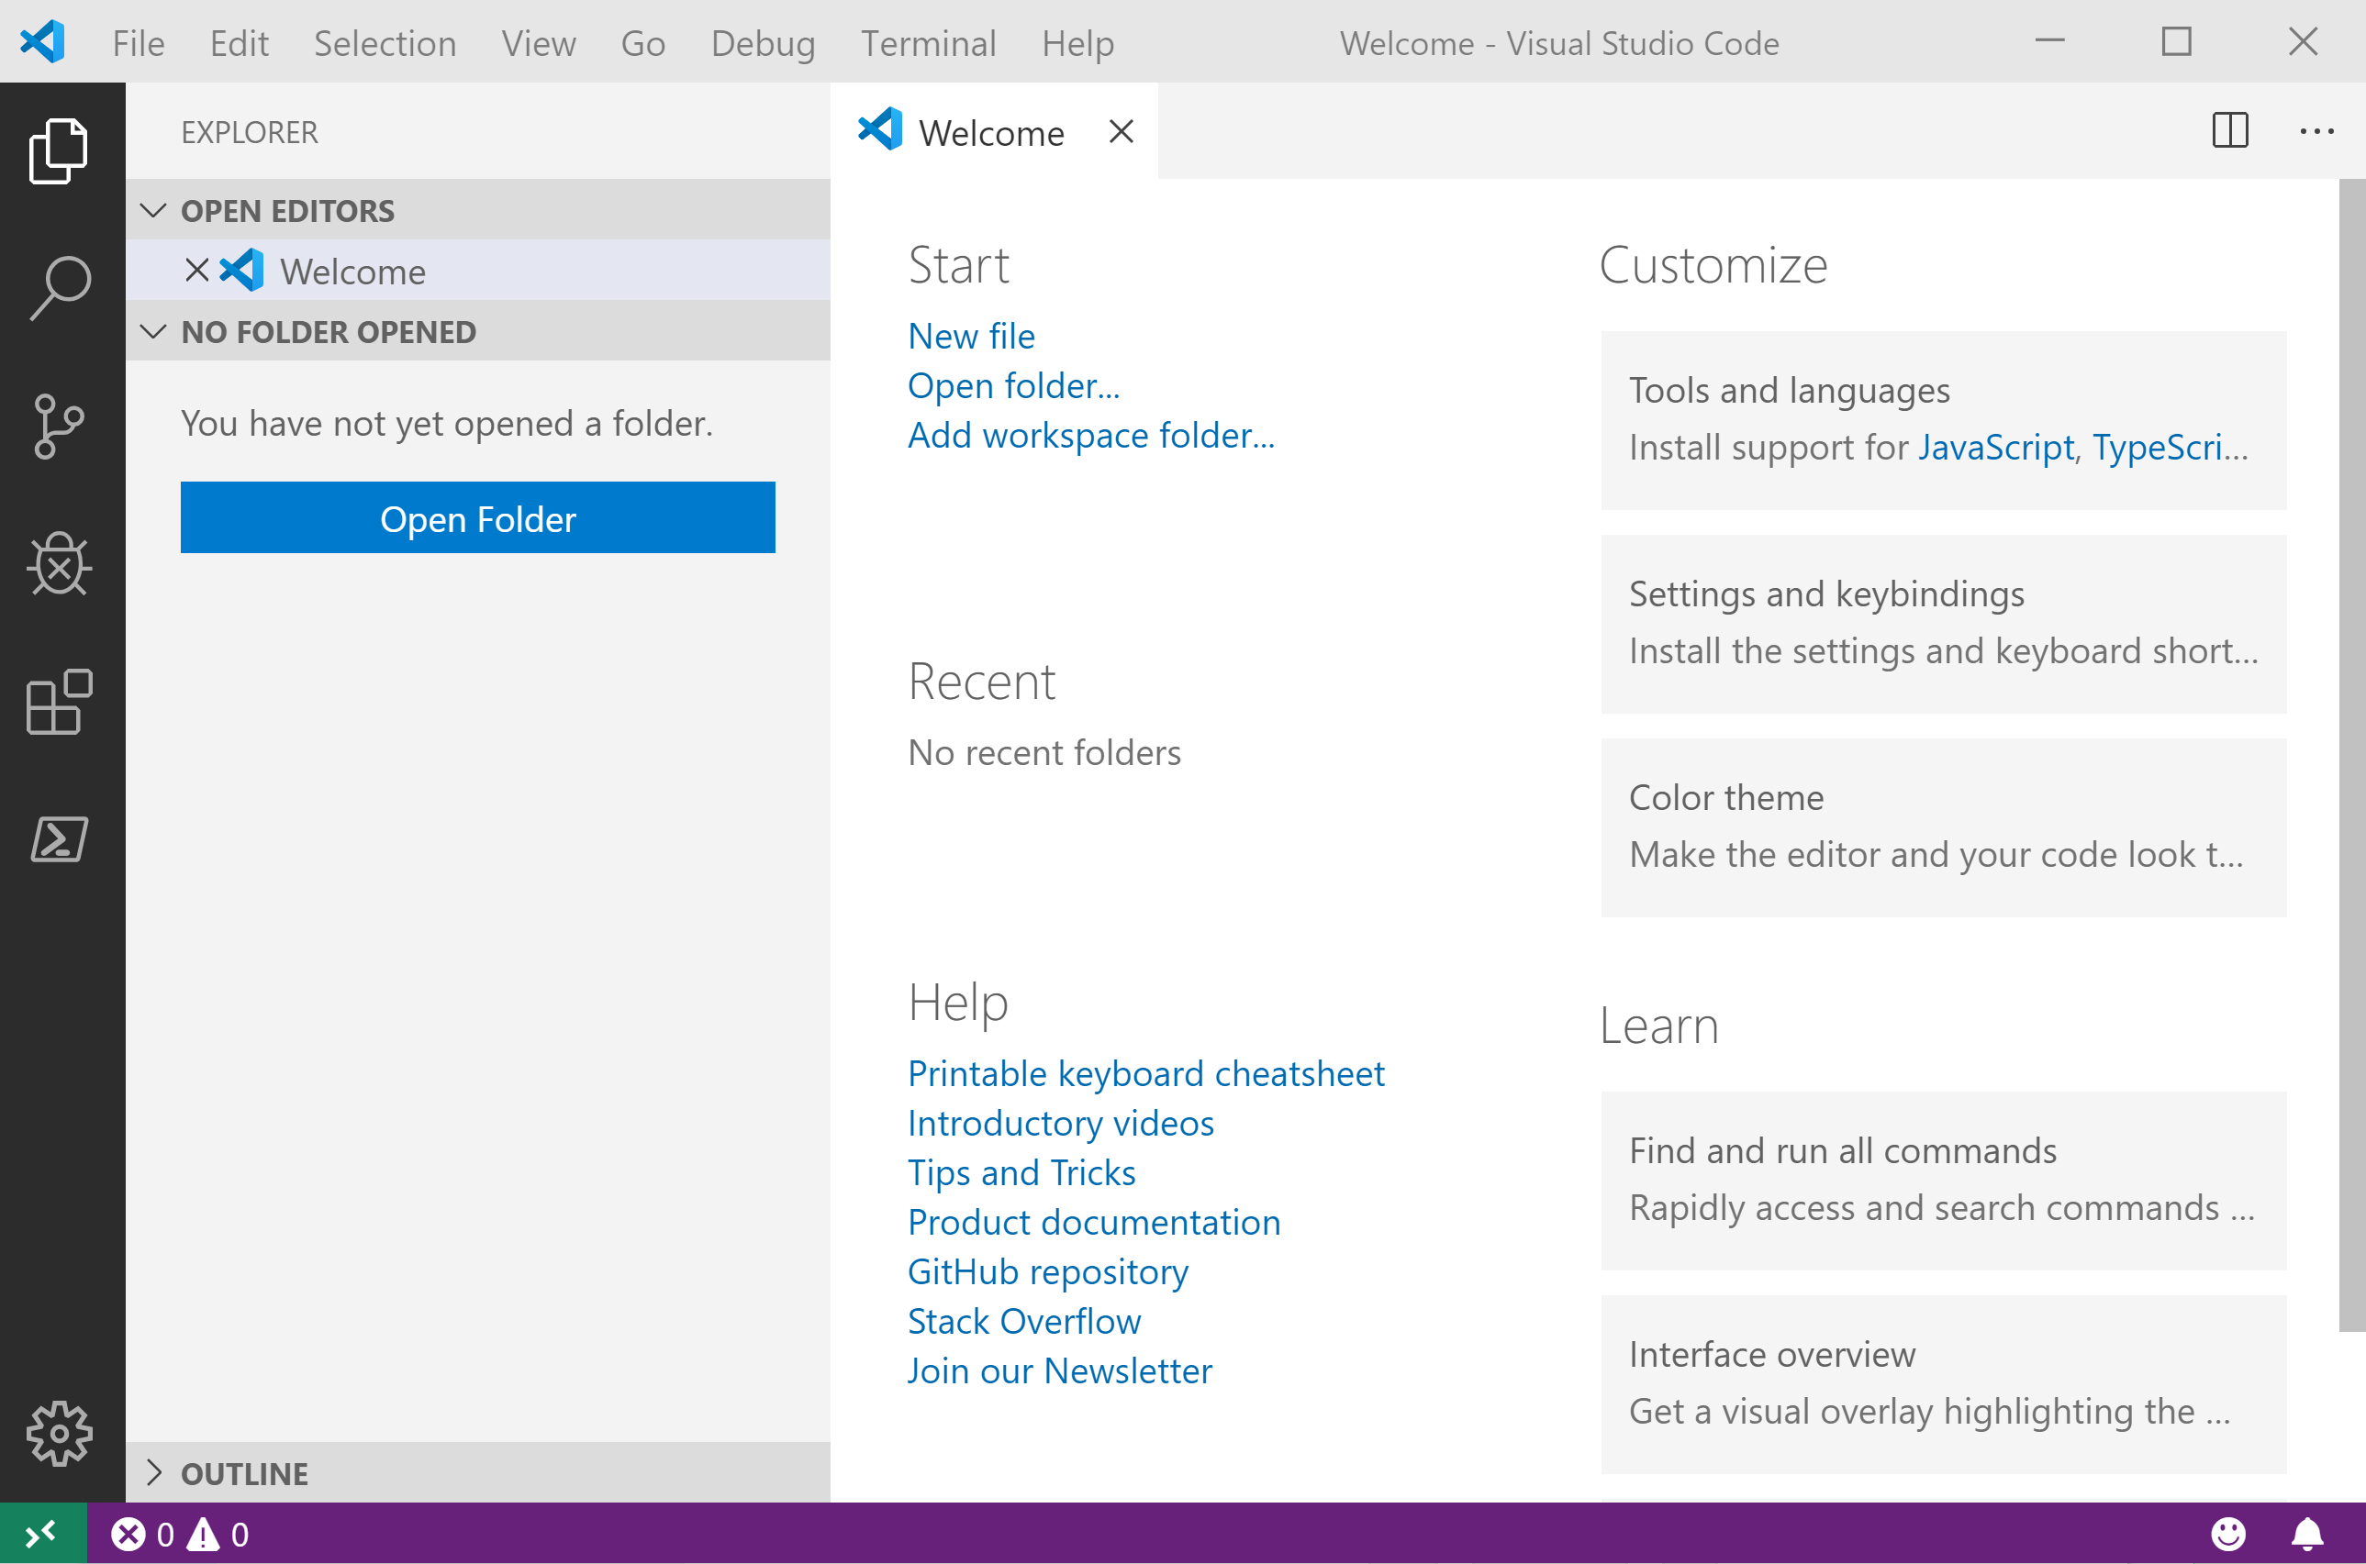
It Looks Like Visual Studio Code ?
Notes:
OBS:SpeakerCentreSquare

Slide 30
.NET Interactive Notebooks
Announced at Ignite but preview announced with PowerShell February 6th 2020 https://devblogs.microsoft.com/dotnet/net-interactive-is-here-net-notebooks-preview-2/

Slide 31
.NET Interactive Notebooks
All the goodness of Jupyter Notebooks with added
PowerShell (and C#) (and F#) (and HTML) (and JavaScript)

Slide 32
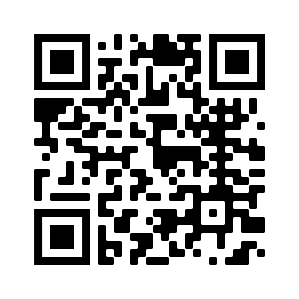
Want to provide feedback on the presentation?
https://www.surveymonkey.com/r/PSKT9VC

Slide 33
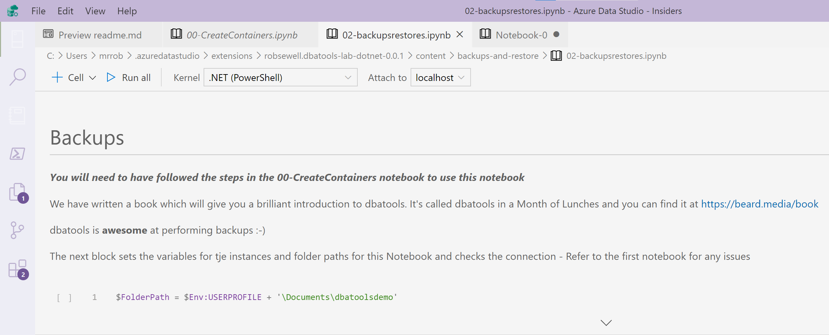
.NET Interactive Notebooks
I like to use them in Azure Data Studio because of familiarity

Slide 34
.NET Interactive Notebooks
I like to use them in Azure Data Studio because of familiarity

Slide 35
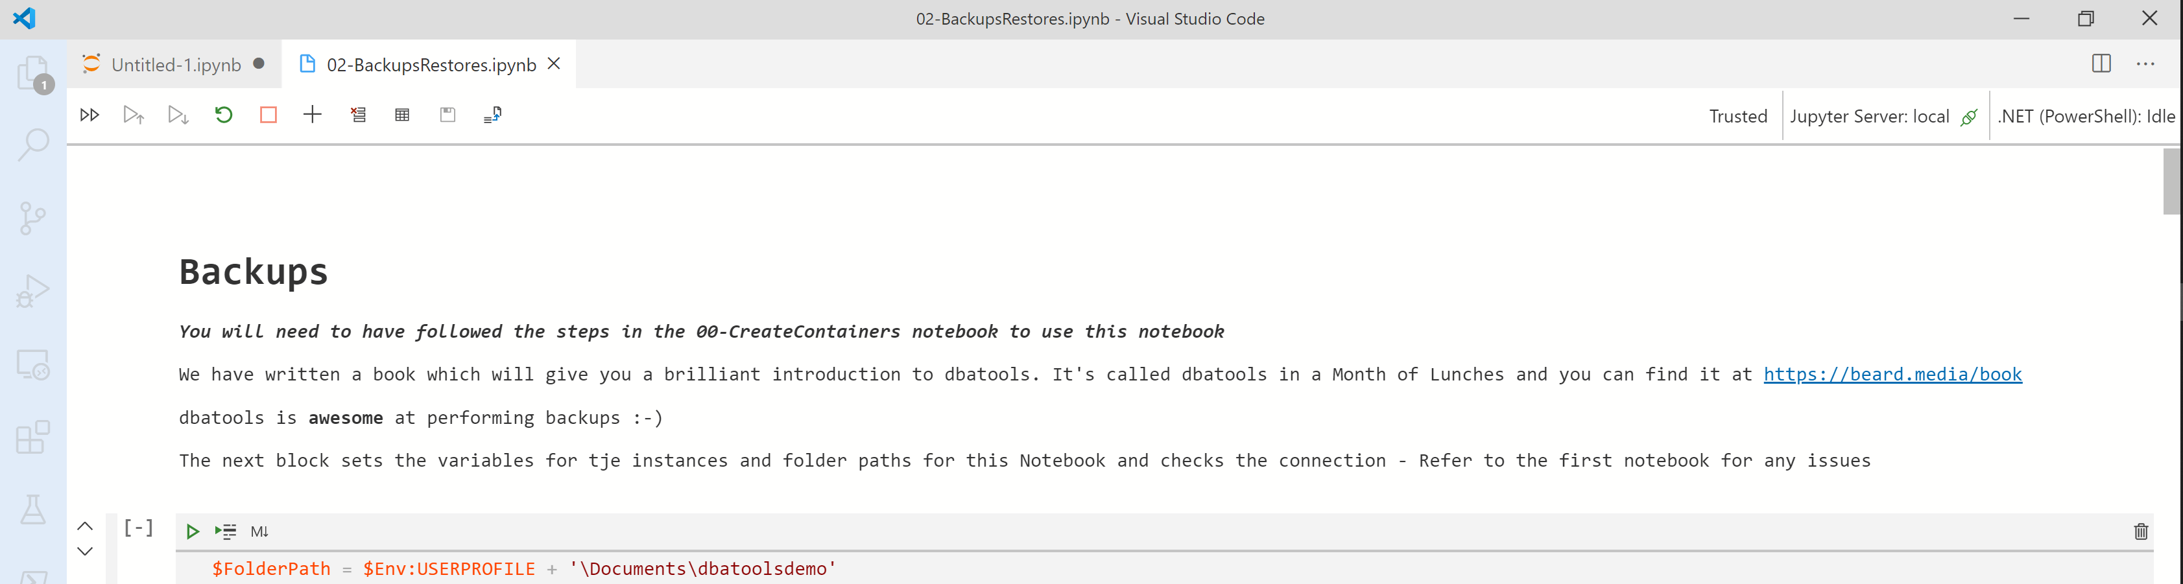
.NET Interactive Notebooks
You can also use them in Visual Studio Code with Python Extension

Slide 36
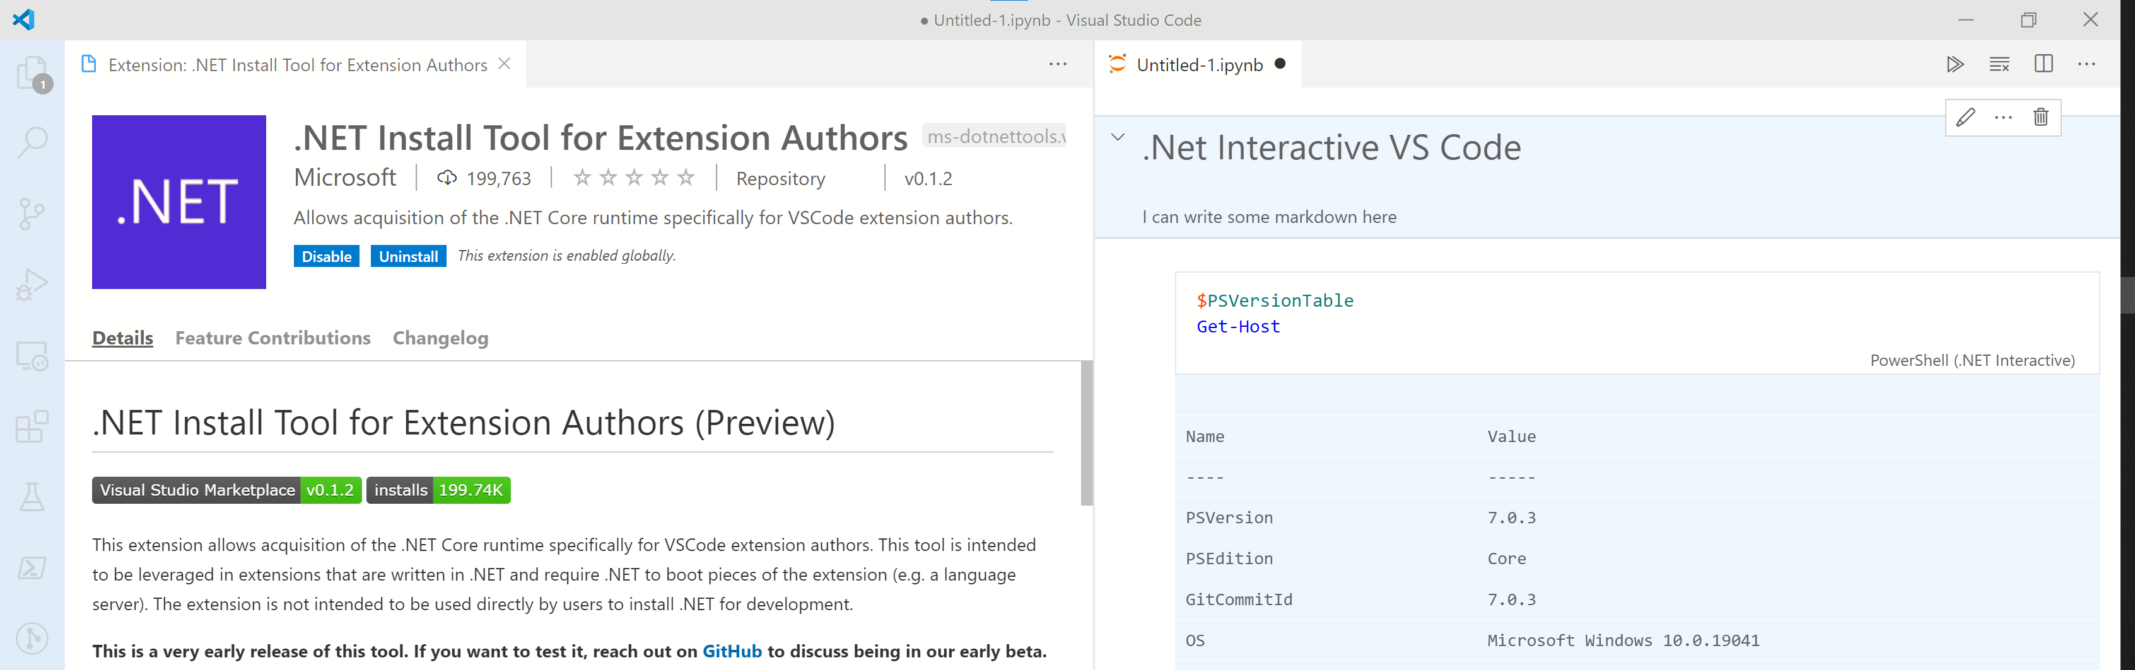
.NET Interactive Notebooks
There is also a Preview Visual Studio Code Extension

Slide 37
Notebook Mode in the PowerShell Preview extension for Visual Studio Code
https://devblogs.microsoft.com/powershell/public-preview-of-notebook-mode-in-the-powershell-preview-extension-for-visual-studio-code/

Slide 38
Enough talk
Lets see it!
Notes:
OBS:SpeakerTopRight

Slide 39
Want to provide feedback on the presentation?
https://www.surveymonkey.com/r/PSKT9VC

